Slide 1
Project 1: Inventory Management System
Simon Powell

Slide 2
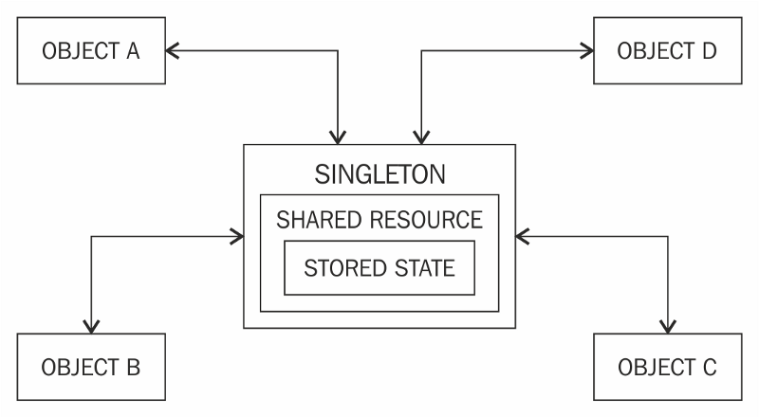
Approach
Design pattern: Singleton
SOLID Principles
Updated documentation
Strong focus on DBMS
Agile approach

Slide 3

Journey
Technologies learnt:
Jira
Github
Google Cloud Platform
Advanced Java
Eclipse
MYSQL
SQL
JUnit
Strong understanding of all of these technologies

Slide 4


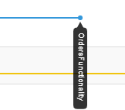
CI Pipeline
Version Control System: Github
DevOps: Java Language
Testing: Junit and Mockito

Slide 5

Testing
IMS coverage: 72.8%
src/main/java coverage: 63.1%

Slide 6
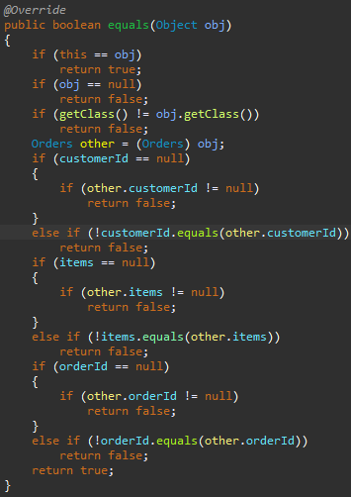
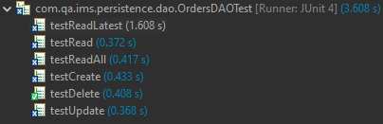
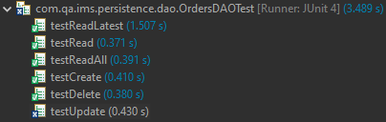
Testing Example 1
Solution:
Generate hashCode() and equals()
Tested Order Functionality

Slide 7
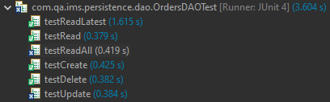
Testing Example 2
Tested ReadAll Results
Within the try-catch of readOrders
Output:
Cause:
Fix:

Slide 8
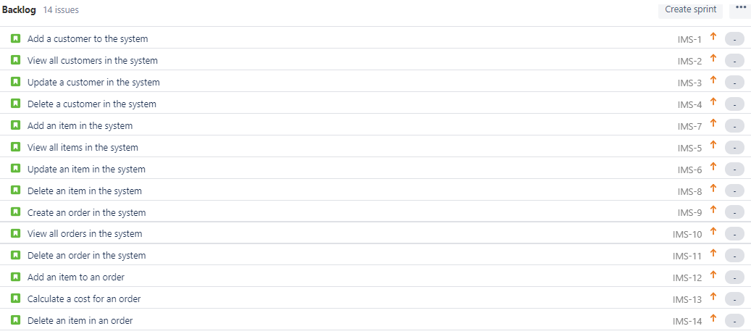
Use of Jira

Slide 9
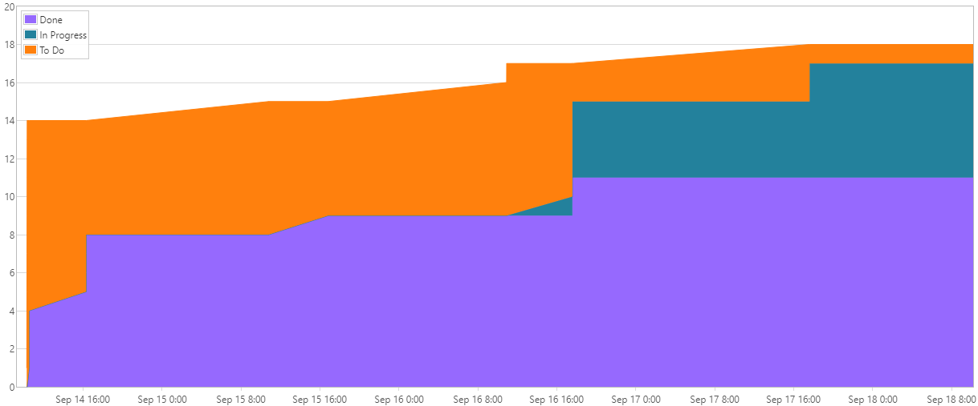
Cumulative Flow Diagram

Slide 10
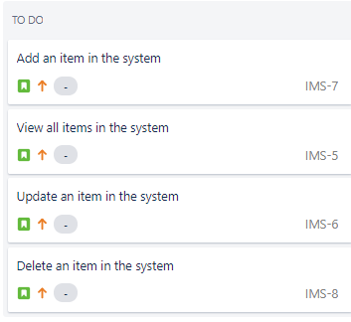
Sprint Review
Completed:
CRUD for Customers, Items and Orders
Testing
Incomplete:
Extensions

Slide 11
Sprint Retrospective
What went well:
Time management for testing and completion of Customers and Items
Improvement:
Time management for testing and completion of Orders
Giving time for the possibility of the addition of extensions

Slide 12
Conclusion
This project was a great personal milestone
Allowed me to understand what I knew and what I needed to improve overall
In the future, I want to revise Java and JUnit in depth

Slide 13
Questions?

